Slide 1
8085 Microprocessor

Slide 2
8085 Microprocessor
It is an 8-bit microprocessor designed by Intel in 1977 using NMOS(N-channel metal-oxide semiconductor) technology.
configuration −
8-bit data bus
16-bit address bus, thus it can address 2¹⁶ = 64 KB of memory
A 16-bit program counter.
A 16-bit stack pointer
Six 8-bit registers arranged in pairs: BC, DE, HL
Requires +5V supply to operate
It can operate with 3 MHz clock
It is used in washing machines, mobile phones, etc.

Slide 3
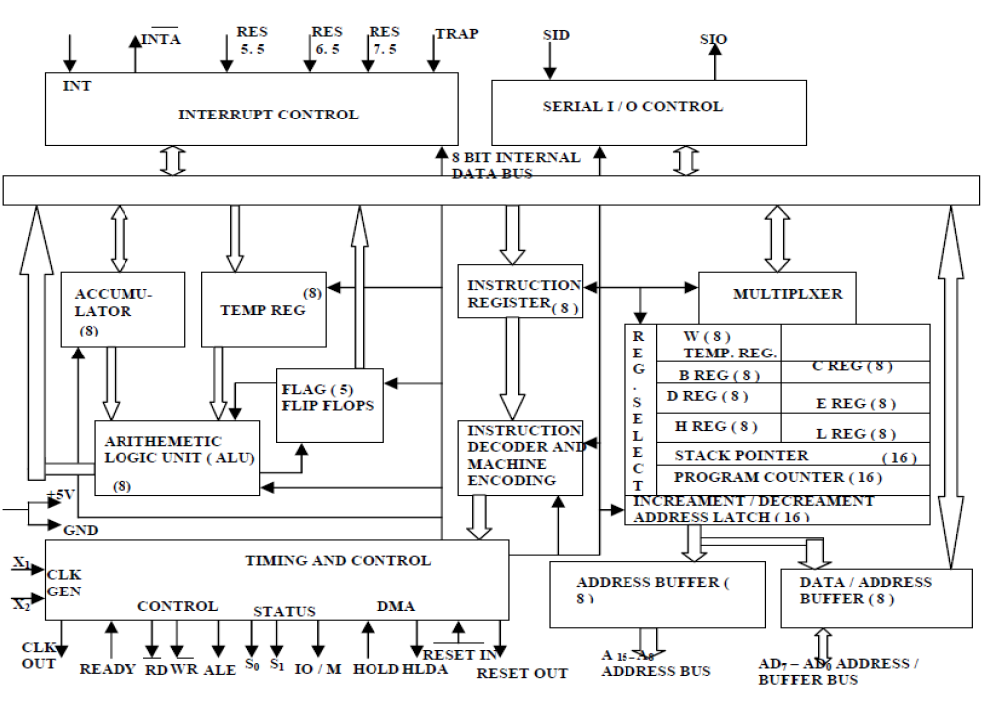
8085 Architecture

Slide 4
Arithmetic and Logic Unit
performs the actual numerical and logical operations such as Addition (ADD), Subtraction (SUB), AND, OR etc.
It uses data from memory and from Accumulator to perform operations.
The results of the arithmetic and logical operations are stored in the accumulator
Registers
-It includes:
    Six 8-bit Registers(General Purpose Registers)
    One 8-bit Accumulator(A)
    One Flag Register(8 bit)
    two 16-bit registers(PC)
    stack pointer(SP)

Slide 5
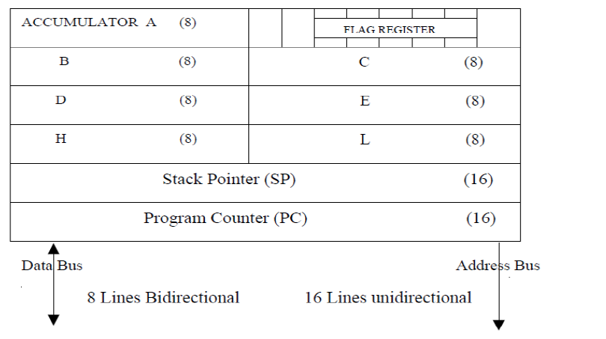
Register Organization
General Purpose Registers
Six general-purpose 8-bit registers ,identified as B, C, D, E, H and L.
They can be combined as register pairs - BC, DE and HL to perform some 16-bit operations

Slide 6
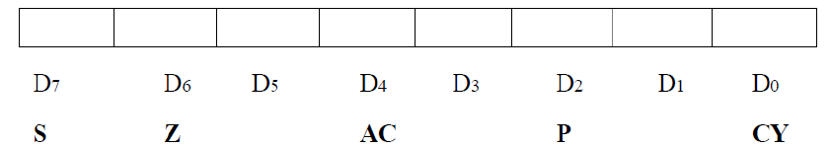
Accumulator
The accumulator(A) is an 8-bit register that is a part of ALU.
It is connected to internal data bus.
Register A is used to store 8-bit data and the result performed by ALU.
Flag register
S-Sign,Z-zero,AC-Auxiliary Carry, P-Parity, CY-Carry
This register is the part of ALU.
It includes 5 flip flops which are set or reset after an operation according to data condition of the result in the accumulator and other registers.
Example( after an addition of two numbers)
CY=1if the result in the accumulator is larger than 8-bit
Z=1, when an arithmetic operation results in zero
S=1, if the number is negative and a positive number has a 0 in 2’s complement representation.
AC=1, when a carry result from bit D3 and passes to bit D4.
P=1, when the result in accumulator contains even number of 1s.

Slide 7
Program Counter (PC)
It is a 16 bit register .
The microprocessor uses this register to sequence the execution of the instructions.
PC is to point to the memory address from which the next byte is to be fetched
When a byte is being fetched, the PC is automatically incremented by one to point to the next memory location.
Stack Pointer (SP)
It is a 16-bit register, used as a memory pointer.
It is a portion of RAM.
It maintains the address of last byte entered into the stack.
The stack pointer incremented each time when data is loaded into the stack and decremented when data is retrieved from the stack.
Instruction Register/Decoder
It is an 8-bit register that temporarily stores the current instruction of a program
Decoder then takes instruction and decodes or interprets the instruction.

Slide 8
Decoded instruction then passed to next stage.
Control Unit
Generates signals on data bus, address bus and control bus within microprocessor
Data Bus:
-The data bus width of 8085 microprocessor is 8-bit i.e. 2⁸ combination of binary digits and are typically identified as D0 – D7.
-larger numbers have to be broken down into chunks of 255. This slows microprocessor.
Address Bus:
-8085 microprocessor contain 16-bit address bus and are generally identified as A0 - A15.
-The higher order address lines (A8 – A15) are unidirectional.
-The lower order lines (A0 – A7) are multiplexed (time-shared) with the eight data bits (D0 – D7) and hence, they are bidirectional.

Slide 9


Control Bus:
-These are various lines which have specific functions for coordinating and controlling microprocessor operations.
-The control bus carries control signals partly unidirectional and partly bidirectional
Different Control signals used by 8085
ALE (Address Latch Enable ): It is a pulse that is provided when an address appears on the AD0 – AD7 lines, after which it becomes 0.
(active low output): The Read signal indicates that data are being read from the selected I/O or memory device and that they are available on the data bus.
(active low output):The Write signal indicates that data on the data bus are to be written into a selected memory or I/O location.

Slide 10

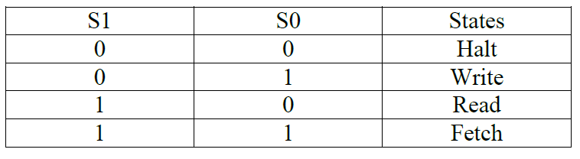
It is a signal that distinguished between a memory operation and an I/O operation. When IO/M= 0 it is a memory operation and IO/M=1 it is an I/O operation.
S1 and S0(output):These are status signals used to specify the type of operation being performed

Slide 11
8085 PIN DESCRIPTION
8085 has 40pins.
All the signals are classified into six groups:
Address bus
Data bus
Control & status signals
Power supply and frequency signals
Externally initiated signals
Serial I/O signals

Slide 12
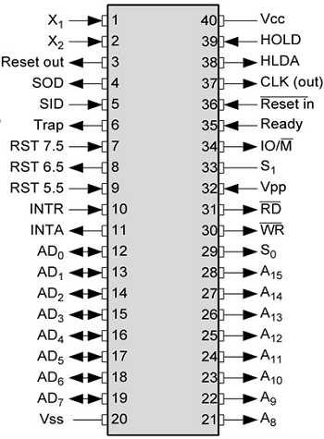
8085 microprocessor pin layout and signal groups

Slide 13
Address and Data Buses:
Address and Data Buses:
A8 – A15 (output): It carries the most significant 8-bits of memory/IO address.
AD0 – AD7 (input/output): It carries Lower significant bits of memory addresses during first clock cycle.
-Carries data during third and fourth clock cycle.
Control and status signals:
These signals are used to identify the nature of operation.
There are 3 control signal and 3 status signals.
Control Signal:
RD − This signal indicates that the selected IO or memory device is to be read and is ready for accepting data available on the data bus.

